Slide 1
Welcome
To Our
Presentation

Slide 2
Presented to: Mansura Momi Department of CSE Daffodil Internation University
Presented By:
Abdulah Al Moin - 0242220005101382
Md.Al Fuyad - 0242220005101002
MD Ruhul Amin - 0242220005101245
Kamrul Islam Leon -0242220005101155
Prokash Chandra Bunik-0242220005101242

Slide 3
Introduction
Abdullah Al Moin
0242220005101382

Slide 4
Newton Raphson
Topic

Slide 5
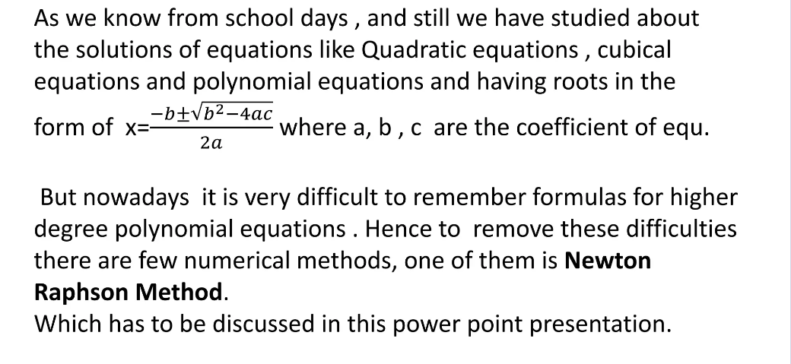
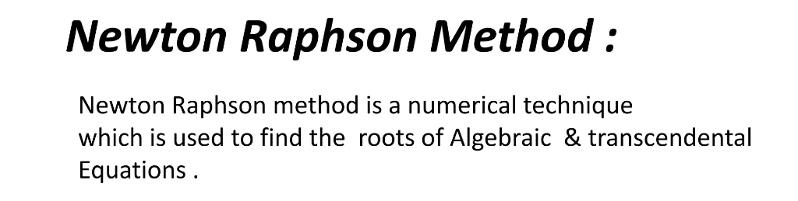


Slide 6
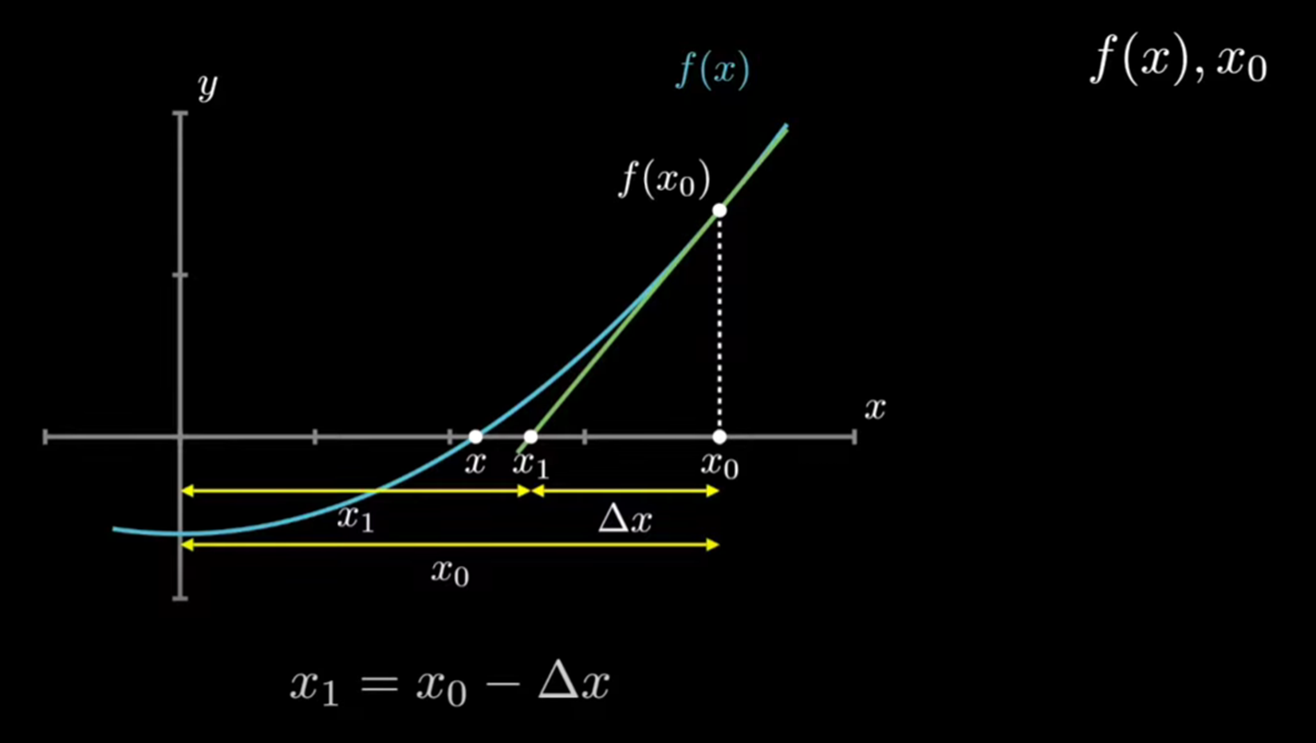
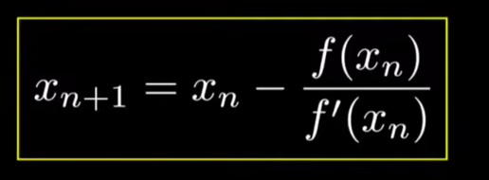
Newton-Raphson Formula And Derivation

Slide 7
Derivation
Md Ruhul Amin
0242220005101245

Slide 8
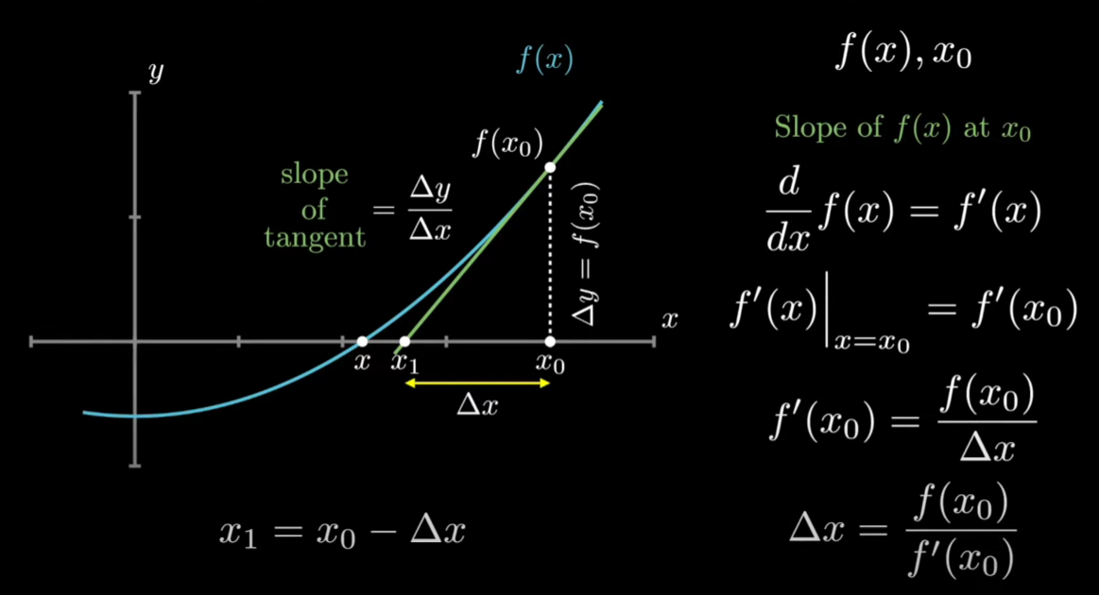

Slide 9
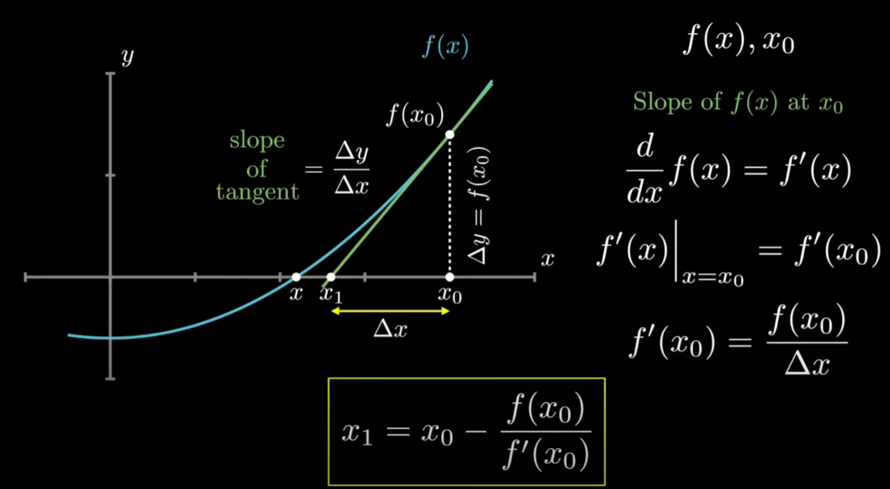

Slide 10
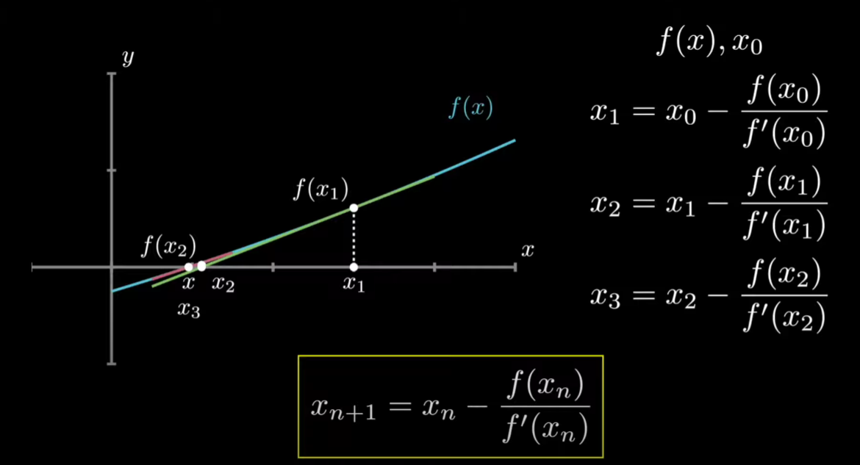

Slide 11
Example
Md Al Fuyad
0242220005101002

Slide 12
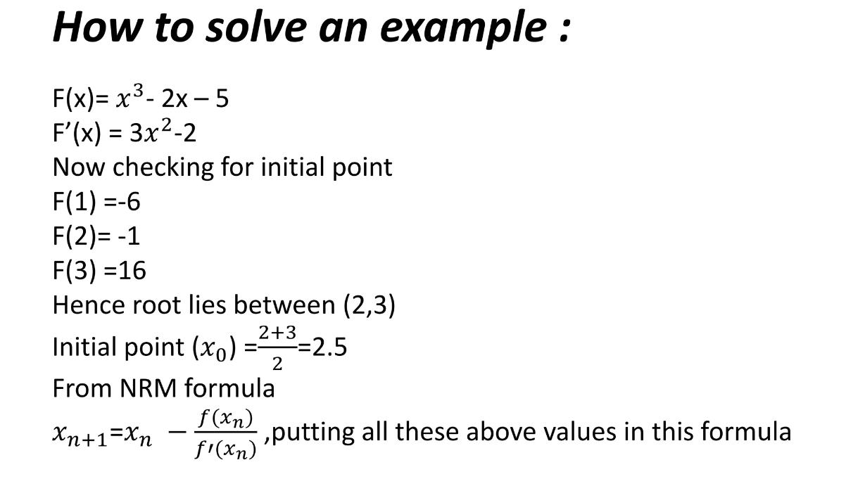

Slide 13
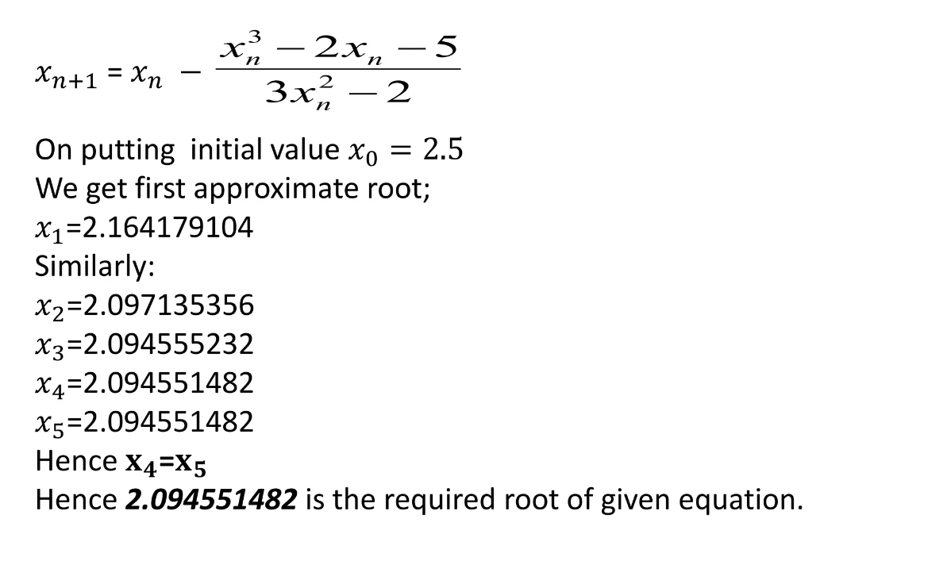

Slide 14
Application
Kamrul Islam Leon
0242220005101155

Slide 15
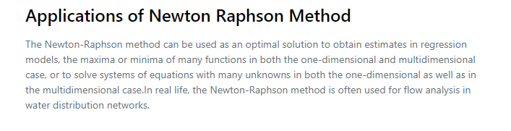

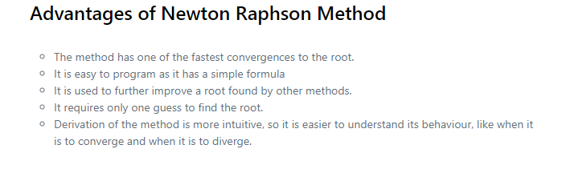

Slide 16
Introduction
Prokash Chandra Bonik
0242220005101242

Slide 17
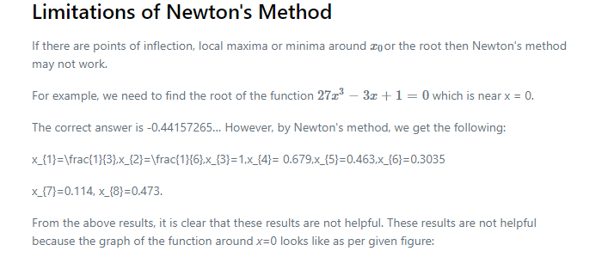

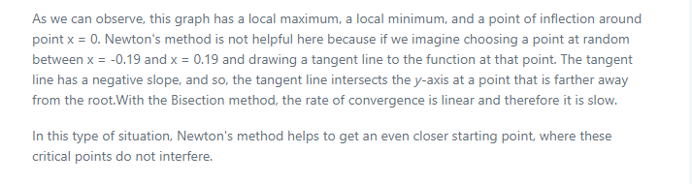


Slide 18

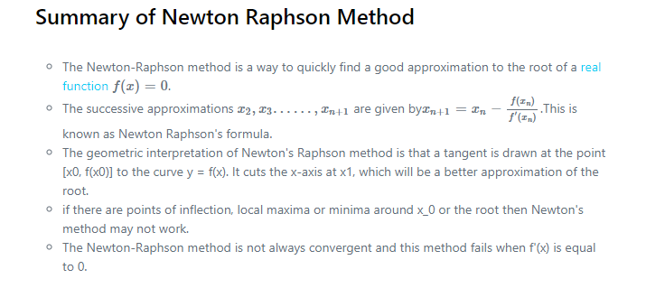

Slide 19
Thank You

Slide 20
